Slide 1
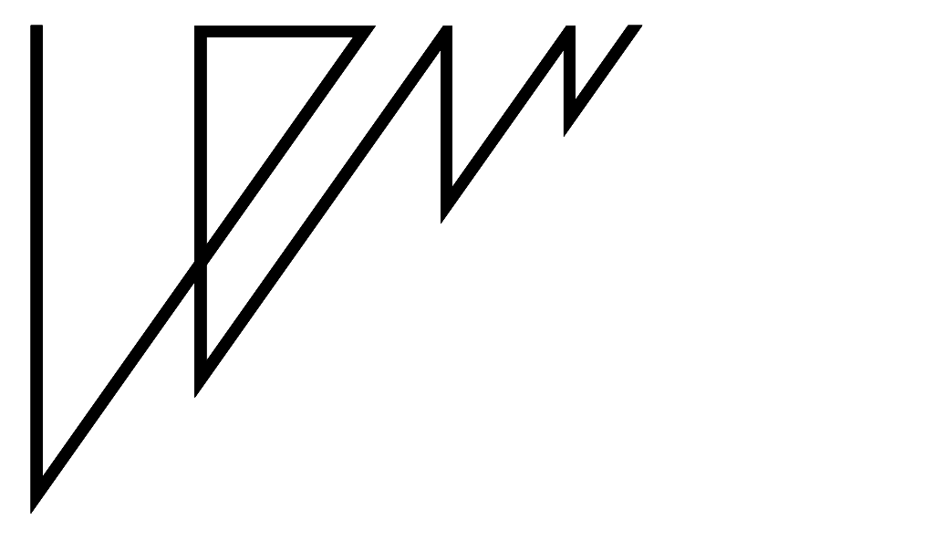
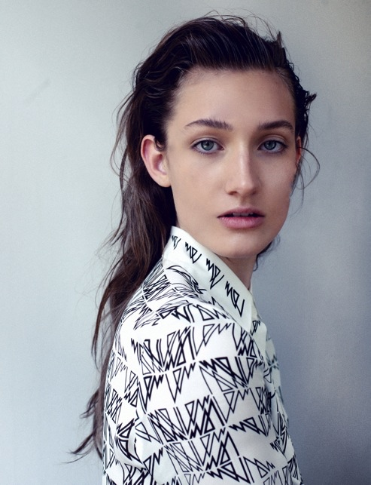
Portfolio LEW
Kim Leemans / Merel Wicker
www.leemansenwicker.nl
Kim@leemansenwicker.nl

Slide 7
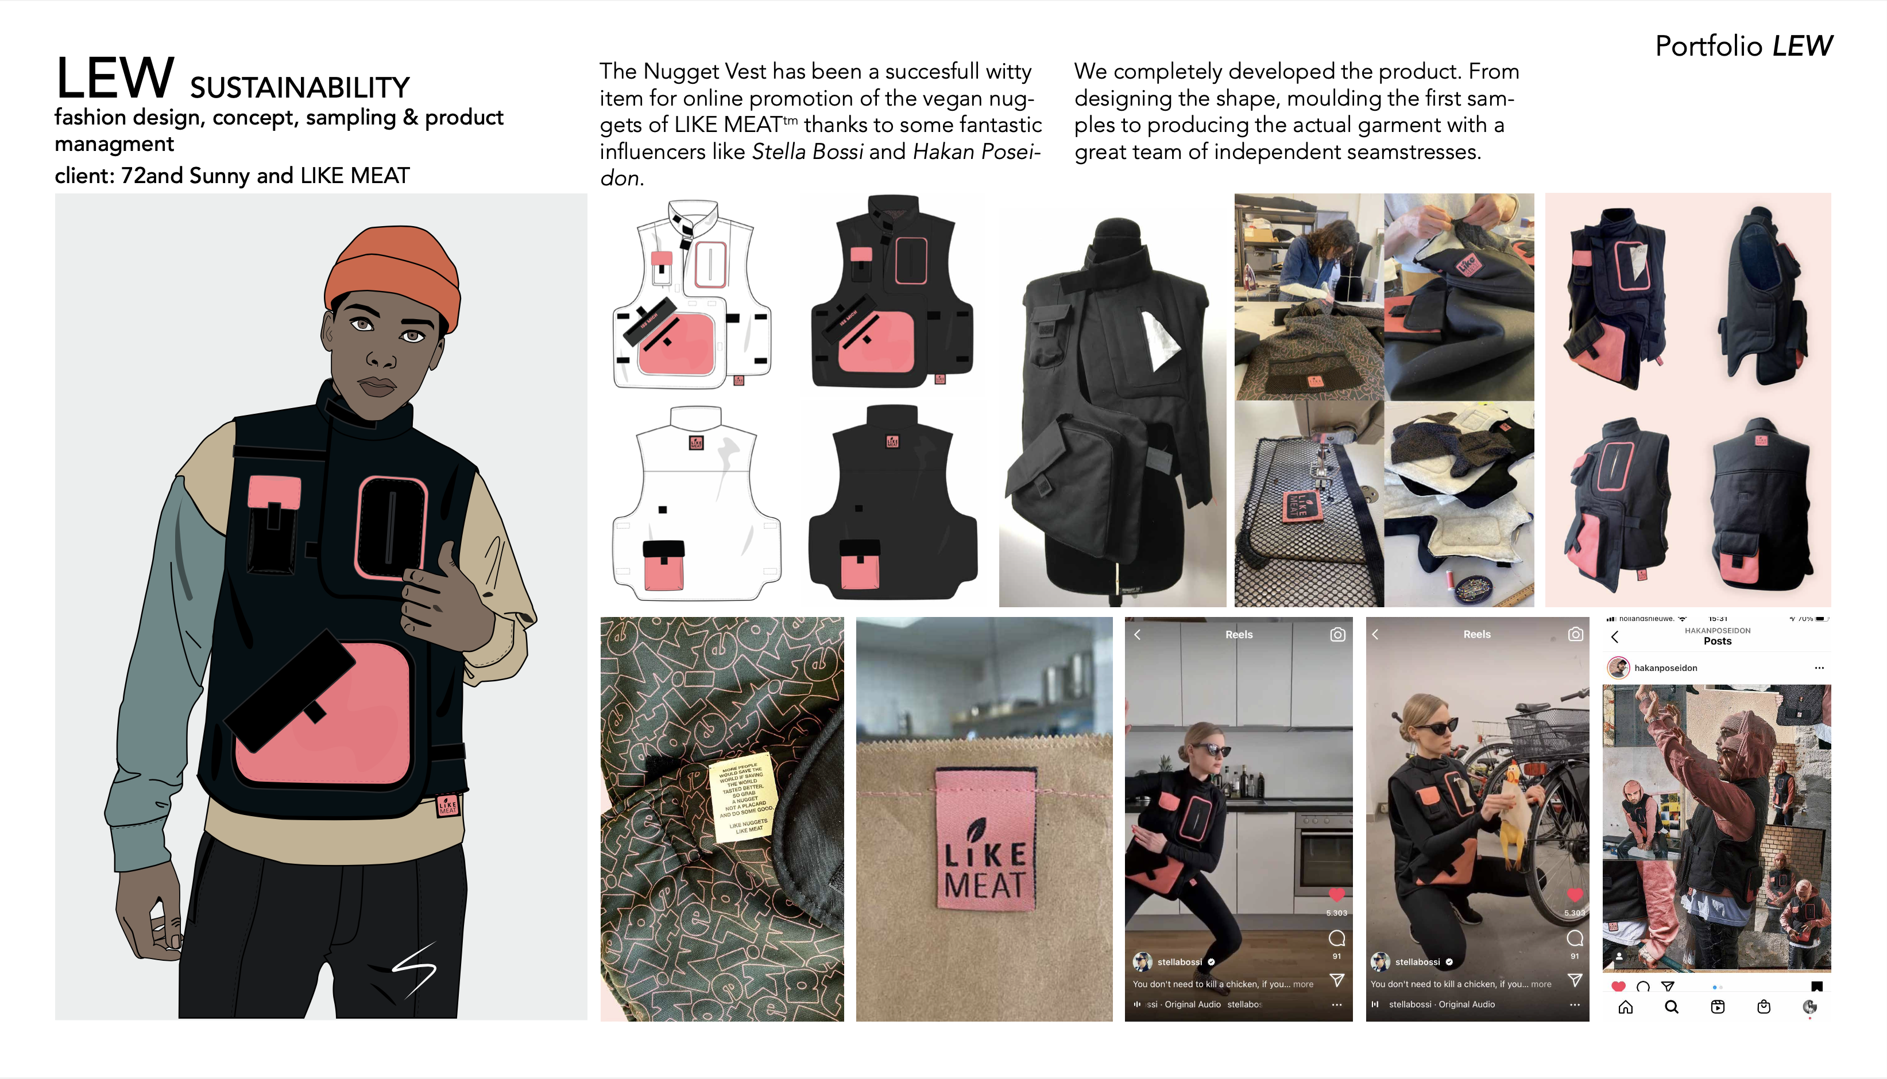

Slide 14
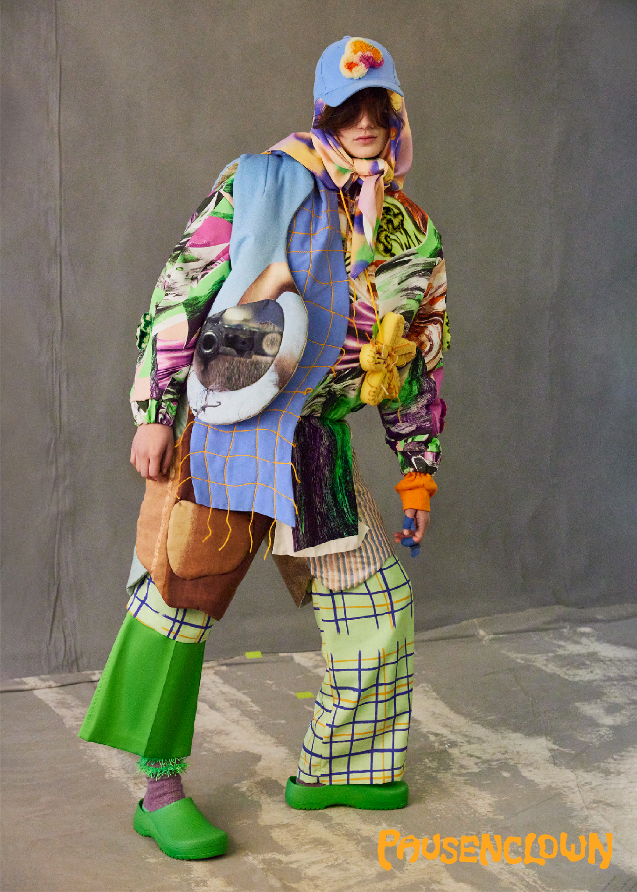
LEW studio presents:
PAUSENCLOWN – Second act
We intuitively started working with old textiles, grandma's wool, left-over materials from earlier collections and old fabrics we found in the attic. Supplemented with a number of hand-drawn prints in which we celebrate the making process of fashion. With Pausenclown we want to share our vision of fashion in which collaboration, sustainability and craftsmanship are important pillars.
This series Second act consists of padded jackets made from 1980s fabrics, handmade punch-needle patches, flower accessories and vests made from
left-over fabrics from a collaboration project with the photographers Petrovsky&Ramone.
To bring this series Second act home Petrovsky&Ramone took these beautiful pictures in which we saw our project come to life.
Photography: Petrovsky&Ramone • Models: Jeske en Ranchilio • Hair & Make-up: Jan Fuite • de Woensdagwinkel / Amsterdam Noord

Slide 15
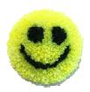
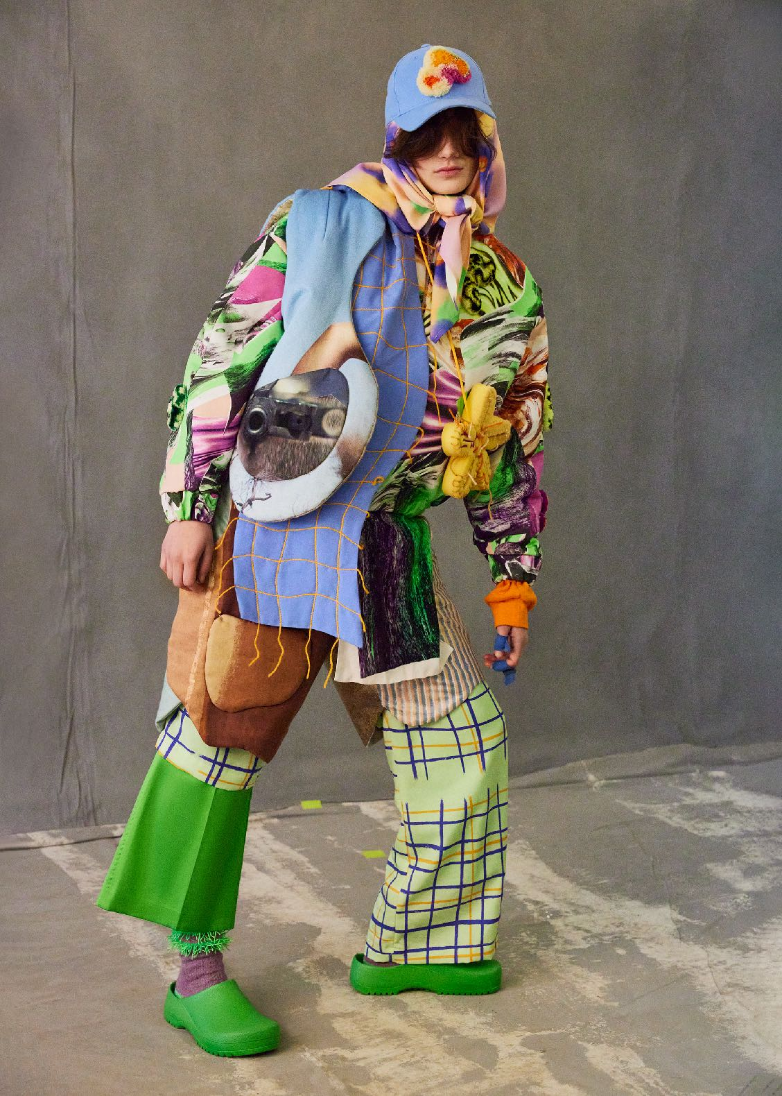
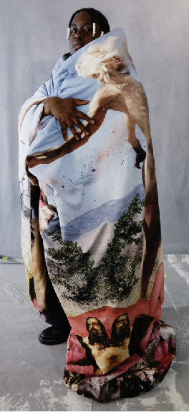
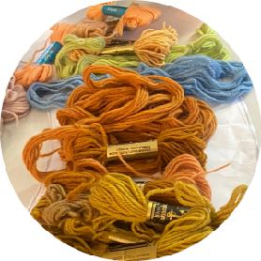
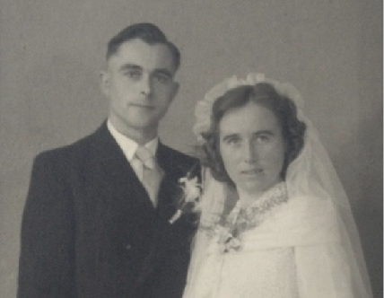
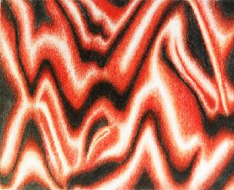
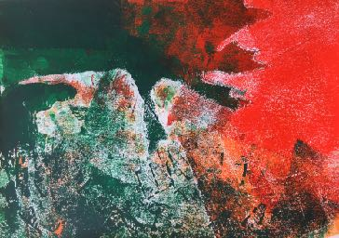
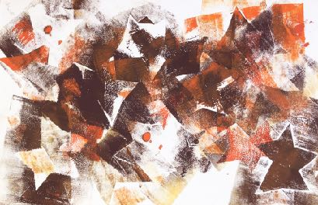
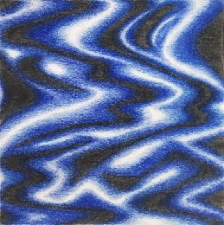
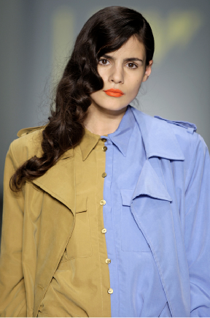
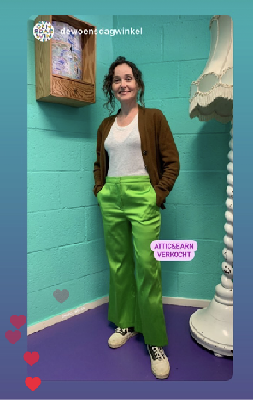
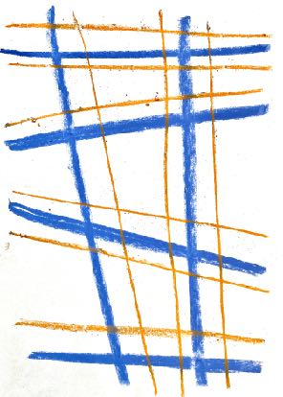
HANDMADE PUNCH NEEDLE PATCH MADE FROM WOOL YARN FROM GRANDPA
PADDED VEST MADE FROM LEFT-OVER DUVET
COVER COLLAB PETROVSKY&RAMONE x LEW
SUSTAINABLE TENCEL FABRIC WITH
HAND-DRAWN DIGITAL FLORAL PRINT
FABRIC: TENCEL
PRINT: RECYCLED DESIGN FROM
MEREL’S OLD CHILDREN’S DRAWING
FLAT SCARF MADE FROM LEFT-OVER FABRIC OF ‘BLUE BOY’ COLLECTION WITH WOOL YARN FROM GRANDPA
FOAM FLOWER ACCESSORY MADE
FROM LEFT-OVER FOAM AND YARN
PADDED ORGANIC SHORTS MADE FROM
80’S FABRIC FOUND IN THE ATTIC
LINING: ECOLOGICAL WOOL
SLEEVE PIECE MADE FROM AN OLD SWEATER
SUSTAINABLE TENCEL FABRIC
WITH HAND-DRAWN CRAYON PRINT
VINTAGE ATTIC&BARN PANTS
FROM DE WOENSDAG WINKEL
WOOL YARN FROM GRANDPA
DESIGNER’S OWNED GARDEN CLOGS

Slide 16
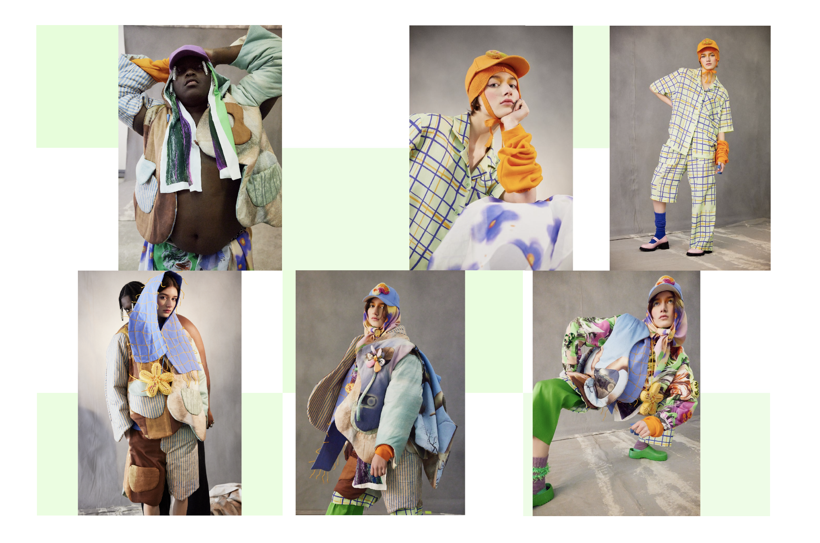

Slide 17
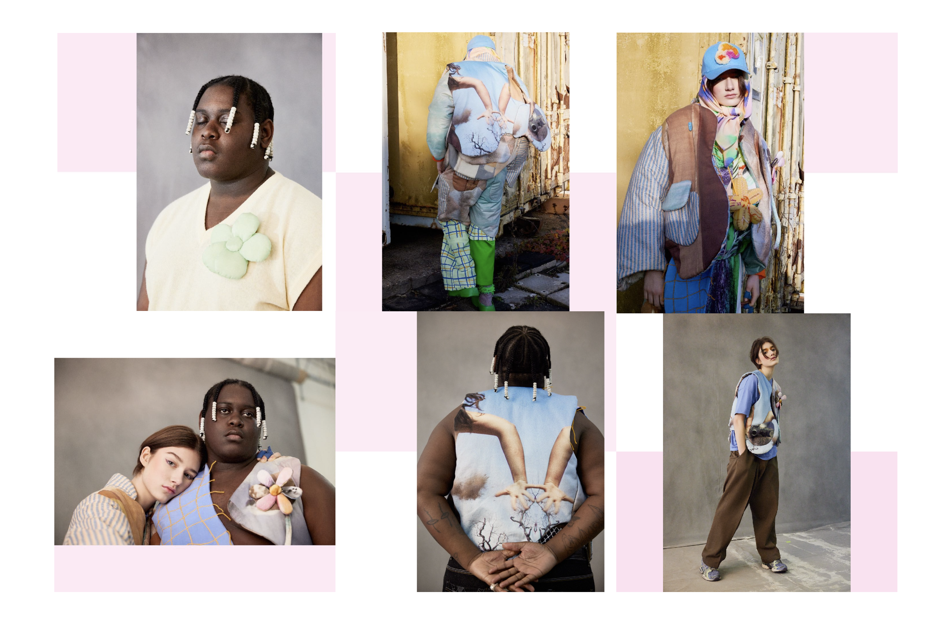

Slide 18
